Slide 1
FRC 4662 Programming
Who What When Why ( HOW Later)
Team introductions!!!

Slide 2
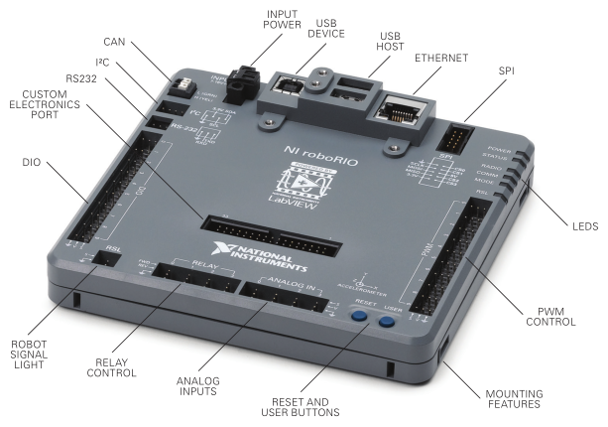
Roborio
National Instruments
ARM processor
Linux
Custom for FIRST

Slide 3
Languages
Labview – National Instruments (proprietary)
4662 used this the first two years
Drag-n-drop icons for objects
“Wire” together to control data and decision flow
Provided Driver Station and some RoboRIO utility code are in Labview
Java – Sun 1995 (now Oracle)
4662 on its third year now C++ - http://www.cplusplus.com/info/history/
used on Arduino – runs the LED string that was on the Competition Robot
Python – unofficial and volunteer supported
https://robotpy.github.io/projects/
FIRST Sponsor WPI (Worchester Polytechnic Institute)
Robotics program participates in DARPA challenge events
Has interns (grad students) write FIRST libraries for Java and C++
Java documentation http://first.wpi.edu/FRC/roborio/release/docs/java/
Hosts a lot of FIRST training material like this https://wpilib.screenstepslive.com/s/4485

Slide 4
Java
Object oriented
“Class” blueprints or provides a framework that can be used to define an object.
Each Class has Methods to define functions for the object.
Instantiation Method(s) to initialize
Multiples methods can be defined with the same name, their specific “signature” is defined by the parameters
used as input. This is called “overloading”.
Syntax is similar to C++ but simpler (which is one of the design goals). Actually similar to many langues (Algol, PL/1)
We’ll discuss key features as we look at sample code.
Java uses “strong typing” which means each variable has to be declared to a type before being assigned.
Native types include things like “Integer”, “Double”, “Char”, and “Boolean”. There are others.
An object is a type and has to be declared and then assigned (instantiated) before being referenced.
Common Syntax things
an “=“ is used to assign values to variables. The variable name appears on the left and the value on the right.
Curly braces are used to bracket major structures like Class, Method, If/Then/Else, Do loops,, etc.
Each line must end with a semi-colon “;”.
Comments can be either double slashes “//” at the front of the line or wrapped “/*” to start and “*/” to end.
Eclipse does a lot of syntax, variable name, and method parameter validation as you type.
There are also many Conventions or Standards that will help identify things like the type and context of a variable
name. You will see these violated in pretty much all the code you see as examples.
Notes:
Do NOT worry about memorizing all the terms. If they’re important, you’ll get them.
Keep reference material handy. Bookmarks in your browser are a good thing.
I learn by reading or getting instruction, doing, then going back to the reading. Iterations to reinforce and maybe direct where I need to learn more.
Basics are design (procedural vs. OO).
The hardest language I had to learn was the second one because I had to break out of designing in a language and design in concepts.
A recent op-ed argued that the language is not important once you have the basics. I currently use four on a regular basis and can dig into others if needed.
Eclipse – sort of like having your Engllsh teacher hanging over your shoulder while you write a paper.
Look at eclipse and structure code

Slide 5
Robot Code in Java
FRC provides the framework and design options for the code as classes in the wpilib plug-in to Eclipse.
We’ve been using “Command Based” design:
powerful structure
starter version generated by RobotBuilder
can be built directly in Eclipse as FRC command types are added by the plug-in
Commands are Scheduled to invoke Methods for Subsystems
e.g. pressing the trigger on the joystick schedules a command to shoot the ball
Another design called Sample Robot (SampleRobot) is used for much of the provided sample code provided with
the wpilib extensions.
Eclipse – explore
Configuring for FRC
Look at some sample code
Robot is an object
States are Instantiation, Initialization, Disabled, Autonomous, TeleOp, and Test (only at home)
Look at ArmSystem Robot, OI, and RobotMap
Github – team site accessible to registered users (it’s free)

Slide 6
Summer Learning - Test Robot Hardware
Goals
Learn PID control coding mechanisms
Work on OO and Better Practices
Actuators
Motors and gearboxes for drive system
Linear Actuator (motorized screw jack)
Speed Controllers
Talon SRX (CTRE)
Talon (now obsolete, available as a discontinued item)
Sensors
Quadrature Encoder
reads rotation speed, distance, and direction
http://www.digikey.com/product-detail/en/AMT102-V/102-1307-ND/827015
Potentiometer
reads position on a rotary scale
can be adapted to a linear scale with a “string” potentiometer
amazon.com search on linear potentiometer 10k
Limit Switches
AndyMark
http://www.andymark.com/

Slide 7
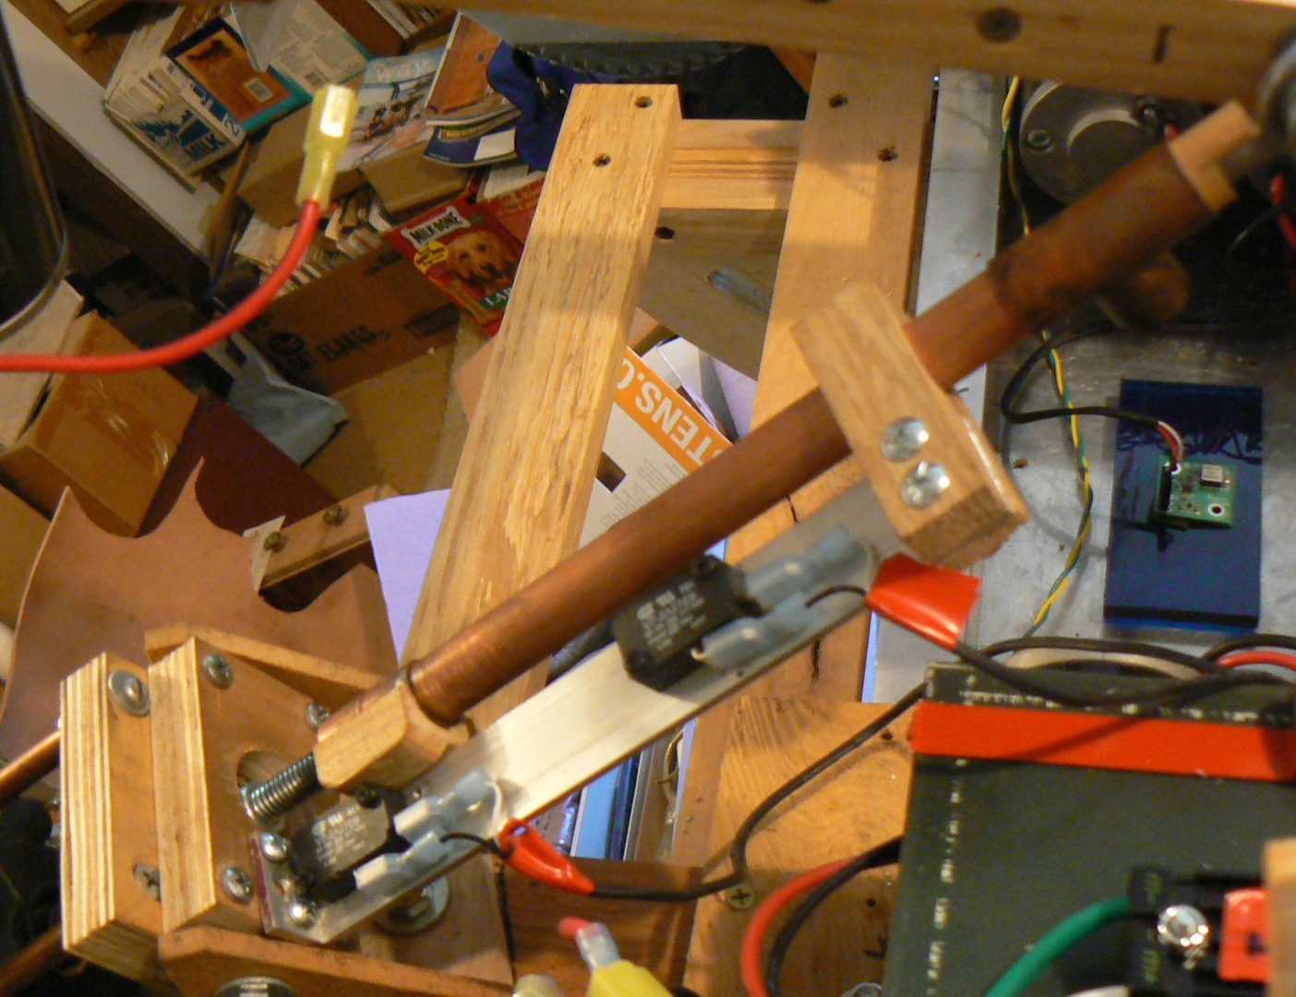
ARM LIFT
“Linear Actuator” home built version
AndyMark Snowblower Motor
All-thread (3/8”)
Misc plumbing parts
Potentiometer
Limit Switches
Also pictured – Gyroscope for Drive System

Slide 8
Actuator - ARmSystem
Command Based
Adopts some “Best Practices” seen in other team’s code samples (NUTRONS)
Java Class Encapsulation Example
An Object is a “thing”
A Class can “blueprint” a “thing”
PID Controller using Potentiometer
Proportional, Integral, Derivative – the theory is a whole topic
Needs work aka Exercises
Initialize routine to save “home” position
Fix the OnTarget method to tie limit switch detection to movement direction
Allow updates to Target Table (e.g. a Save Setpoint command)
Use true/false for table increment command rather than hard-code
Read/Write Setpoint table from RoboRIO stored file

Slide 9
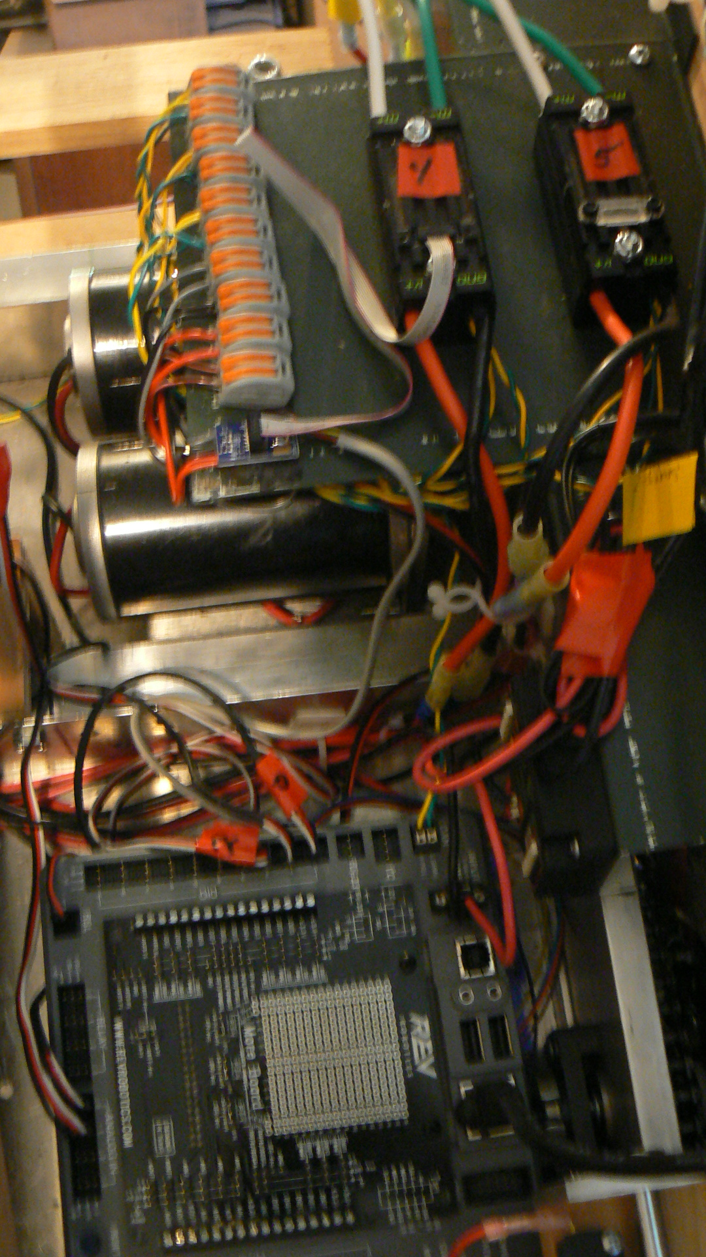
Drive system
RoboRIO
Talon SRX with Encoder and Limit Switch Breakout board
2 CIM Drive
Gearbox

Slide 10
Drive - PIDLing2gyro
Command Based
Pre “Best Practices” (as delivered from FRC provided RobotBuilder)
PID Encoder control using Talon SRX connected on Right side drive
Gyro read – not incorporated into drive
Needs Work– More Exercises
PID Encoder control of both Left and Right drive for distance
PID Gyro control of Left and Right drive for heading (self-steering)
HINT – Nutron code base does this and a lot more (link from Chief Delphi to Github)
isStuck/inTrouble methods
Got Stuck? Handle overloads / drive errors for autonomous

Slide 11
Shopping
AndyMark http://www.andymark.com/Default.asp
FRC major supplier
Cross The Road Electronics http://www.ctr-electronics.com/
FRC custom electronics
VEX Robotics http://www.vexrobotics.com/vexpro
FRC drive parts and electronics
Digi-key http://www.digikey.com/en
electronics and connectors (voucher)
Mouser http://www.mouser.com/
electronics and connectors
Amazon http://amazon.com
learn to search (potentiometers, bearings, rod ends, etc.)
eBay http://ebay.com
learn to search (linear actuators, Anderson powerpole, etc.)
Hansen Hobbies http://www.hansenhobbies.com/
bulk PWM cable parts
Surplus Gizmos http://www.surplusgizmos.com/
surplus electronics and tech parts shop in Hillboro (on Cornelius Pass Road)

Slide 12
References
FIRST http://www.firstinspires.org/robotics/frc
Oregon FIRST http://oregonfirst.org/
National Instrumets https://decibel.ni.com/content/community/academic/student_competitions/frc
Chief Delphi (FRC Discussion Forum) https://www.chiefdelphi.com/forums/index.php
FRC 2016 Control System https://wpilib.screenstepslive.com/s/4485
Java Training http://docs.oracle.com/javase/tutorial/
Java Docs http://docs.oracle.com/javase/8/docs/api/
Java WPILib http://first.wpi.edu/FRC/roborio/release/docs/java/
Eclipse https://eclipse.org/
Github https://github.com/

